Slide 1

N.B.K.R. INSTITUTE OF SCIENCE AND TECHNOLOGY
SIMPLE
BANKING APPLICATION

Slide 2
TEAM MEMBERS
NAME ROLL NUMBER
1). M.NISHITHA 24KB1A05AT
2). M.RISHITHANJALI 24KB1A05Z9
3). M.SOHITHA 24KB1A05Y5
4). M.ALOUKITHASURIN 24KB1A05Y2

Slide 3

INTRODUCTION:
A simple banking application allows users to manage their finances digitally.
It provides basic features like viewing account balance, transferring money, and checking transaction history, all through a secure and easy-to-use interface.

Slide 4

OBJECTIVE:
The objective of this application is to provide users with a secure and convenient way to perform basic banking tasks such as ,
checking balances
transferring funds
viewing transaction history anytime, anywhere.

Slide 5
SOFTWARE REQUIRMENT ANALYSIS
1. Functional Requirements:
User registration and login with authentication (e.g., OTP, password).View account balance and details.Transfer funds between accounts.View transaction history.Bill payment functionality (optional).Logout and session timeout handling.
2. Non-Functional Requirements:Secure data transmission using HTTPS/SSL.Fast response time and low latency.
User-friendly and intuitive UI/UX design.Cross-platform compatibility (for mobile apps).High availability and reliability.Scalable backend to support growing user base.
3. Hardware Requirements:Server with sufficient memory and storage.
Smartphones (Android/iOS) for end users.

Slide 6
Software Design: The software design of a simple banking application is structured into different layers to ensure modularity, maintainability, and scalability.
1. Architecture:Client-Server Model: The application follows a client-server architecture where the frontend communicates with the backend via APIs.
2. Design Layers:Presentation Layer (Frontend):Built using Flutter/Android SDK.Handles UI components and user interactions.Sends requests to the backend and displays responses.
3. Database Design:Tables: Users, Accounts, Transactions, Beneficiaries.Relationships:One user can have multiple accounts.One account can have many transactions.
4. Security Design:End-to-end encryption for data transmission.Secure authentication (e.g., JWT, OAuth, or Firebase Auth).Role-based access control (admin, user).Input validation and error handling.

Slide 7
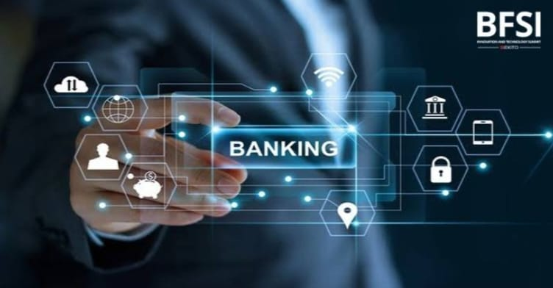
ADVANTAGES:
1.User-Friendly Interface
2. Faster Performance
3. Lower Development and Maintenance Costs
4. Better Security Management
5. Quick Updates and Improvements

Slide 8
DISADVANTAGES:
Limited Features
Poor Scalability
Less Competitive
May Appear Less Professional
Limited Customer Support Tools

Slide 9
CODE LINK:
https://1drv.ms/p/c/5f607d03ab36f732/EYzUELhJdhtDm9BZ_x4cgZYBDI30vmZRLuxaMpH9_jme3w?e=GzqPbS

Slide 10

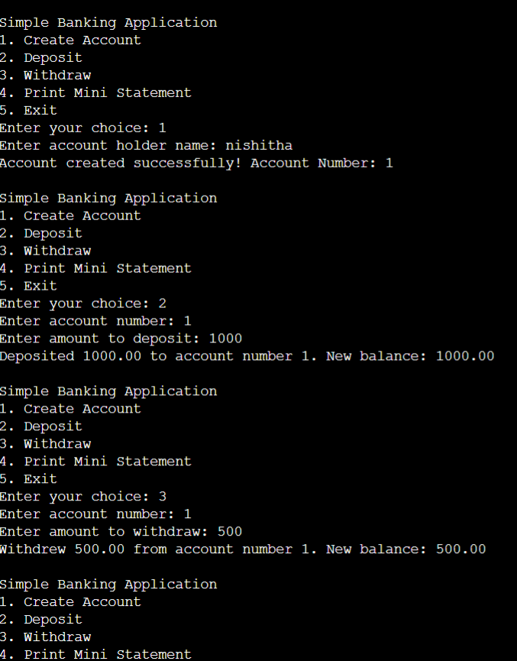
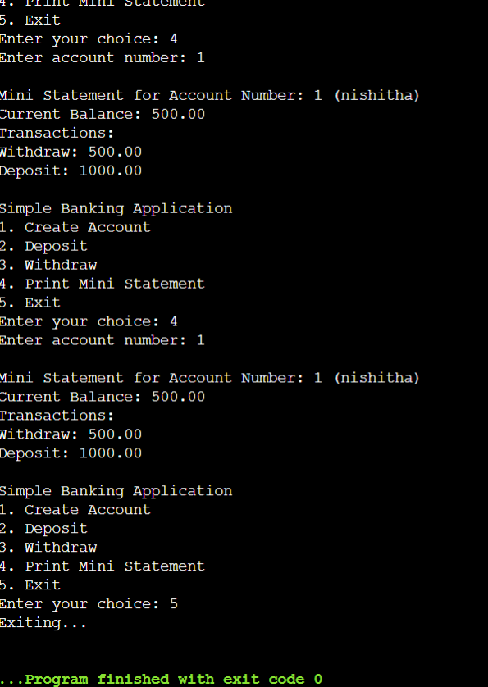
OUTPUTS:

Slide 11
CONCLUSION:
The simple banking application successfully simplifies everyday banking by providing core features like balance checks, fund transfers, and transaction history. It ensures a secure and user-friendly experience, making banking accessible anytime, anywhere.

Slide 12
ANY QUESTIONS TO BE ASKED?

Slide 13
THANK YOU!

